Slide 1

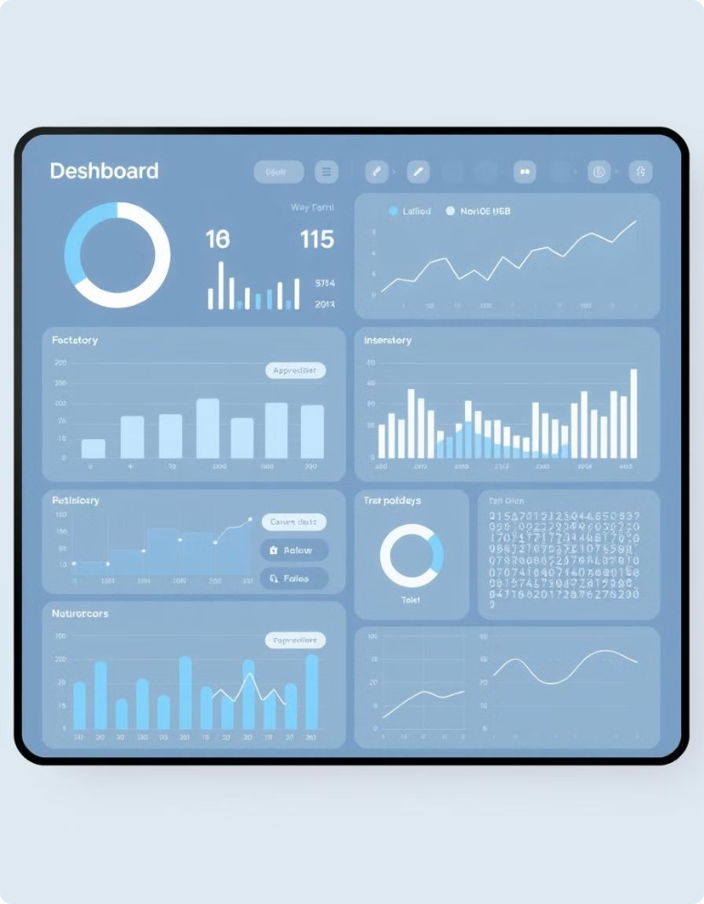
AI-Powered Weather Dashboard
Our AI-powered weather dashboard delivers precise, real-time weather forecasts. It provides hyperlocal predictions, detailed visualizations, and insightful future outlooks. The user-friendly interface makes accessing and interpreting this crucial weather data effortless, benefiting both daily planning and strategic decision-making.

Slide 2
AI-Powered Weather Dashboard: Overview
Real-Time Weather Data
Predictive Analytics
The platform provides real-time weather data. This includes current conditions, forecasts, and historical weather records. Data is collected from a variety of sources.
The platform uses advanced AI algorithms to predict future weather conditions. These predictions can be used to prepare for severe weather events.
Personalized Alerts
Data-Driven Decision-Making
The platform allows users to create custom weather alerts based on their location and preferences. This includes notifications for extreme weather events, like heavy rain, snow, or high winds.
The platform empowers users to make informed decisions based on accurate weather data and predictive analytics.

Slide 3
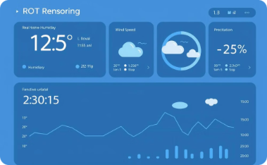

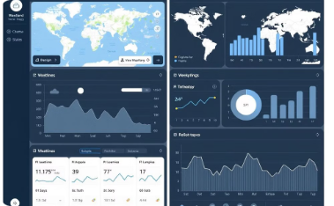
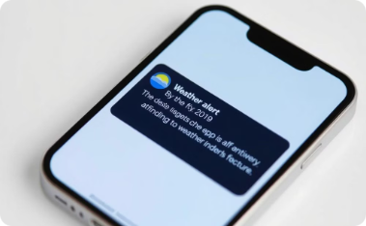
Key Features
Real-time updates:
AI-based predictions
Interactive visualizations
Custom alerts
Users can set alerts for specific weather events, like heavy rain or snow.
The platform provides constantly updated weather data.
Advanced algorithms generate accurate forecasts for future weather conditions.
Users can explore weather data through maps, charts, and other interactive elements.

Slide 4
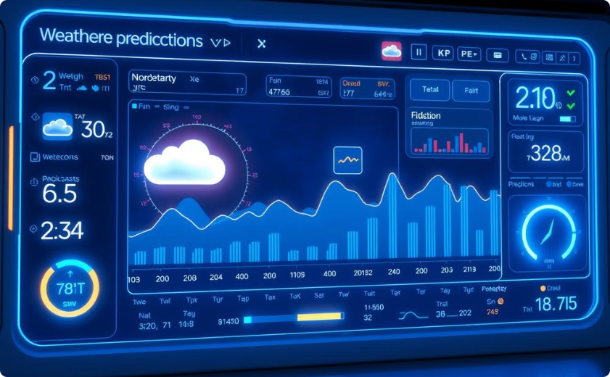
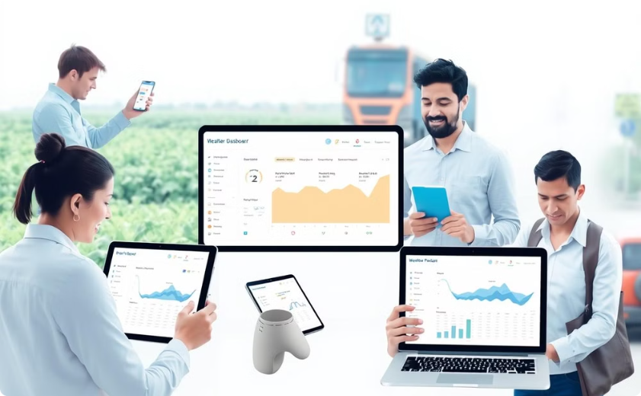
Benefits & Applications
Enhanced Accuracy
Better Safety & Resource Management
AI-powered weather forecasting offers significantly more precise and reliable predictions than traditional methods, utilizing extensive datasets from diverse sources for improved forecast accuracy.
Accurate weather predictions are crucial for enhanced safety, enabling proactive planning and preparation for various weather events. Industries like agriculture and transportation benefit from better resource management due to precise forecasting.

Slide 5
Future Vision
1
Hyper-localized Data Integration
2
AI-powered Climate Impact Studies
This will provide more precise weather insights, down to a specific neighborhood or street level.
This will help understand and predict the long-term effects of climate change on weather patterns.
3
Enhanced Data Security
4
Improved User Interface
The platform will prioritize user privacy and data security through advanced encryption and access controls.
We are constantly working to enhance the user experience through intuitive design and user-friendly features.
"Transforming weather insights with AI for a safer, smarter future."

